Slide 1
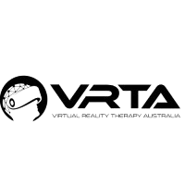
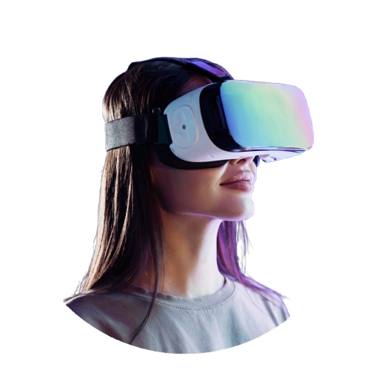
Corporate Program for Queensland Police
Empowering Resilience and Mental Health through Virtual Reality Therapy

Slide 2
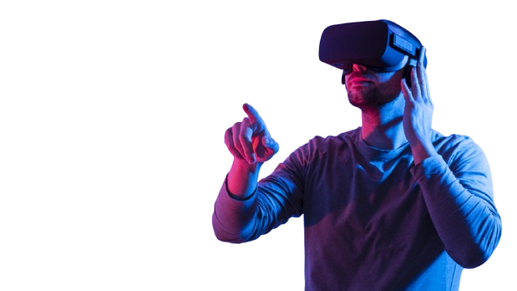
About Virtual Reality Therapy Australia (VRTA)
Specialising in innovative mental health solutions using immersive Virtual Reality (VR) therapy.
Empowering professionals to build resilience, manage stress, and enhance well-being.
Over 20 years of experience in justice-related environments.

Slide 3

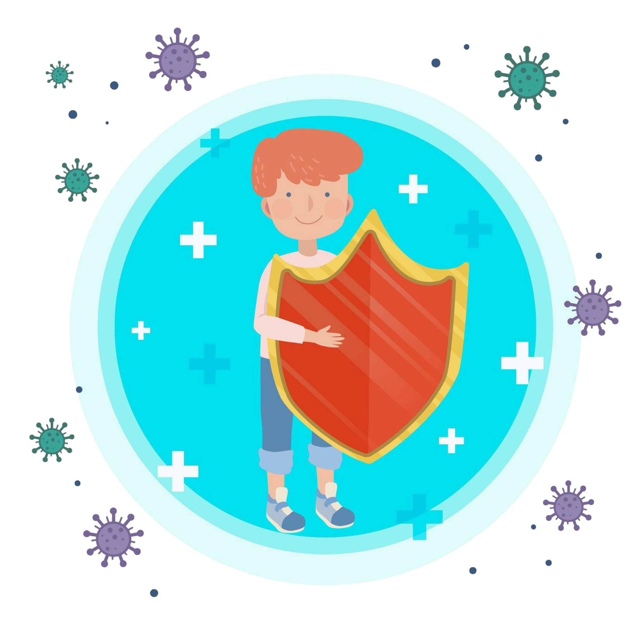


Understanding Your Needs
High stress and trauma exposure.
Stigma around accessing traditional therapy methods.
Officers in rural or remote areas with limited mental health support.
Demanding, unpredictable rosters making flexibility essential.

Slide 4
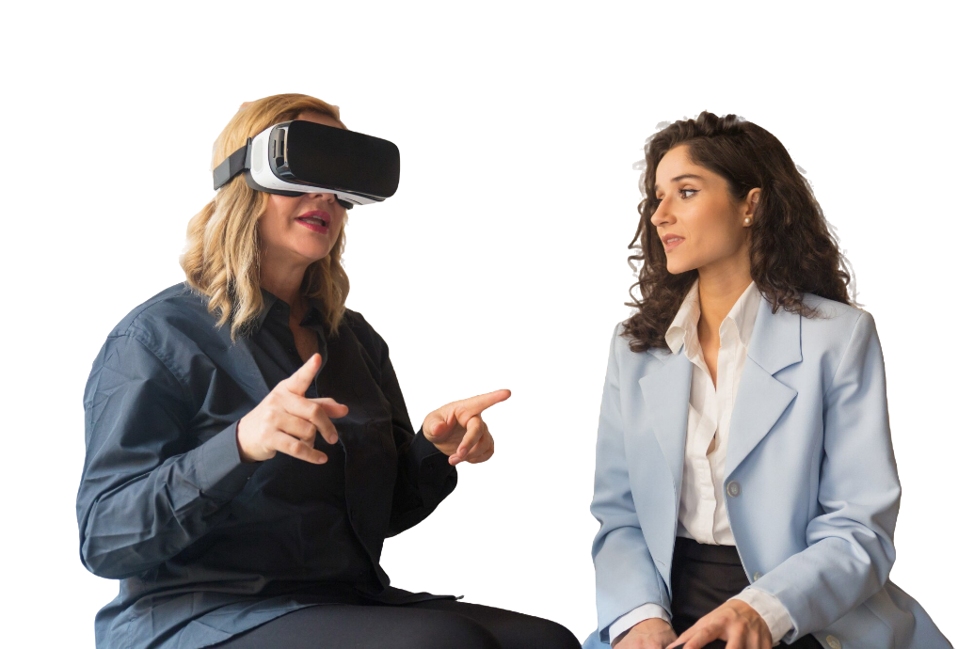
Tailored Solutions for Queensland Police
Features | Benefits | Requirements
Bespoke VR therapy sessions customised for police officers.
Flexible delivery: in-person, virtual, or via phone.
Accessible anywhere with a working internet connection.
Flexible timing: Sessions from 7am–10pm to fit all rosters.

Slide 5
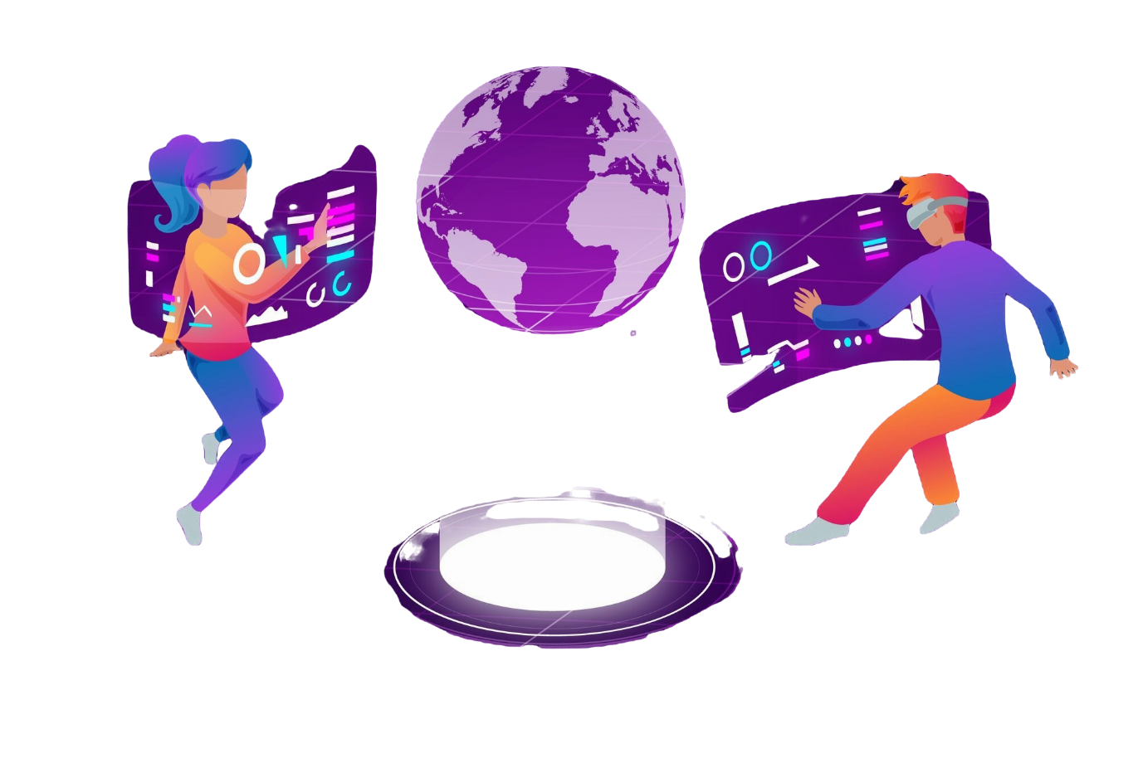
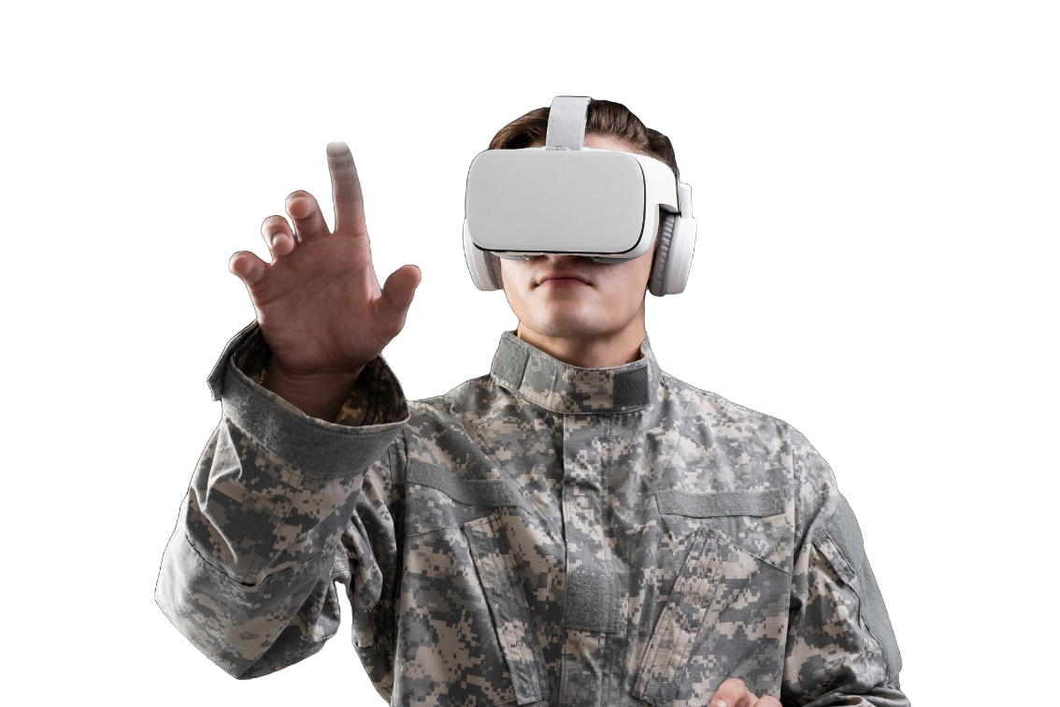
Why VR Therapy Works
Proven use in high-stress professions like military and police worldwide.
Innovative and engaging approach to therapy.
Effective for stress management and trauma recovery.
Cutting-edge solution combining immersive technology with evidence-based practices.

Slide 6
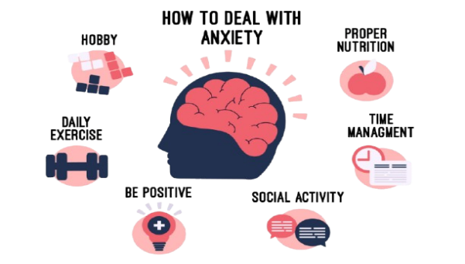

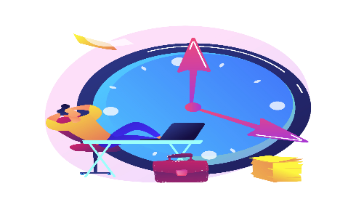
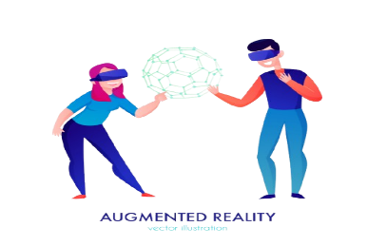
Key Benefits of VR Therapy
Stress Management: Reduces anxiety through immersive mindfulness exercises.
Trauma Recovery: Aids PTSD recovery in safe, controlled environments.
Flexibility: Accessible anywhere, fitting various rosters.
Nationwide Reach: Tailored for officers in both urban and remote areas

